Slide 1
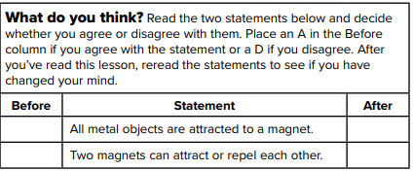
U1M3L1 Magnetic Forces

Slide 2
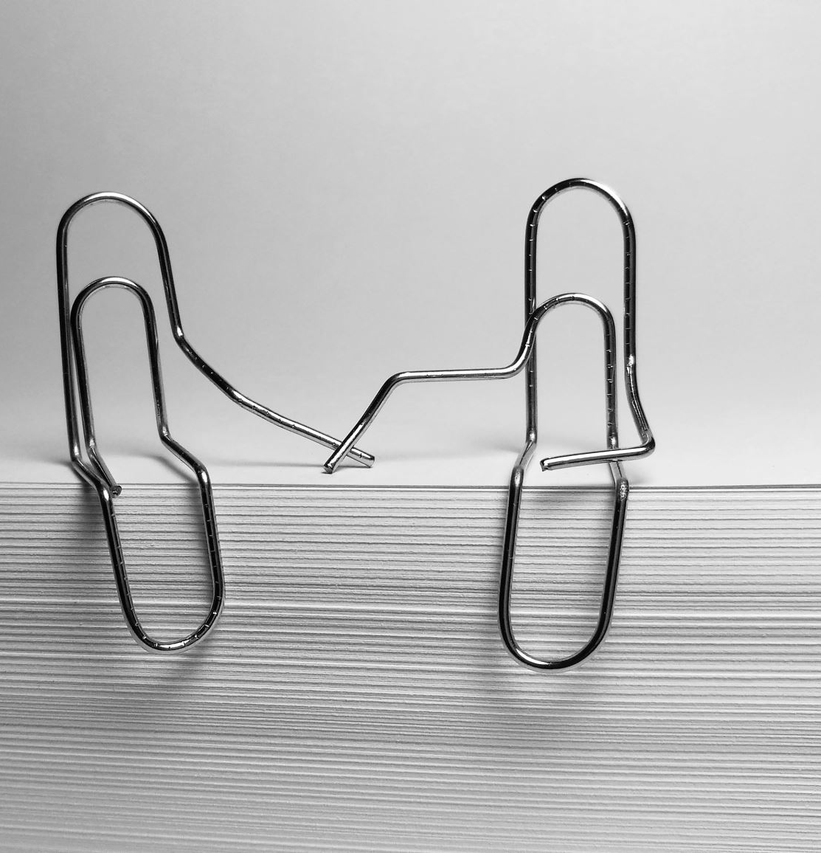
What is a magnetic force?
magnets attract some objects, such as paper clips. But a magnet will not attract other objects, such pieces of paper.
Magnetic Materials A magnet is an object that attracts iron or other materials that have magnetic qualities similar to iron.
A magnet attracts paper clips and some nails because they contain iron. Any materials that is strongly attracted to a magnet is a magnetic materials.
Magnetic materials often contain ferromagnetic (fer oh mag NEH tik) elements. Ferromagnetic elements include iron, nickel, and cobalt. These elements have a strong attraction to magnets

Slide 4
magnetic forces
A force of attraction or repulsion created by a magnet is a magnetic force.
A magnetic force is a noncontact force which means it can apply a force without being in direct contact with another object.
This is why a magnet can cause a paper clip to move without touching it

Slide 5
Where is the force of a magnet strongest?
You might have noticed that the ends of some magnets are different colors or labeled N and S.
These colors and labels identify the magnet’s magnetic poles

Slide 6
Magnetic Poles
A magnetic pole is a place on a magnet where the force it applies is strongest.
All magnets have two magnetic poles—a north pole and a south pole. As shown in the figure, if a magnet is broken into pieces, each piece will have a north pole and a south pole.

Slide 7
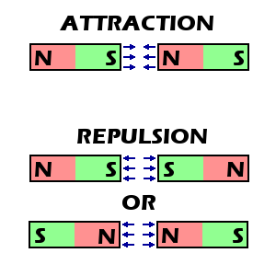
The Forces Between Magnetic Poles
A force exists between the poles of two magnets. If similar poles of two magnets, such as north and north, are brought near each other, the magnets repel.
If opposite poles of two magnets are brought near each other, the magnets attract. A magnetic force becomes stronger as magnets move together and weaker as magnets move apart.

Slide 8
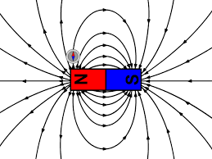
How can you model the force of a magnet?
An invisible magnetic field surrounds all magnets. This magnetic field applies forces on other magnets and magnetic materials. This force applies even when the magnetic material is not in contact with the magnet.

Slide 9
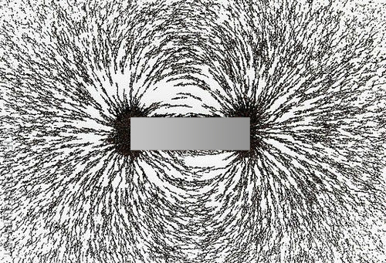
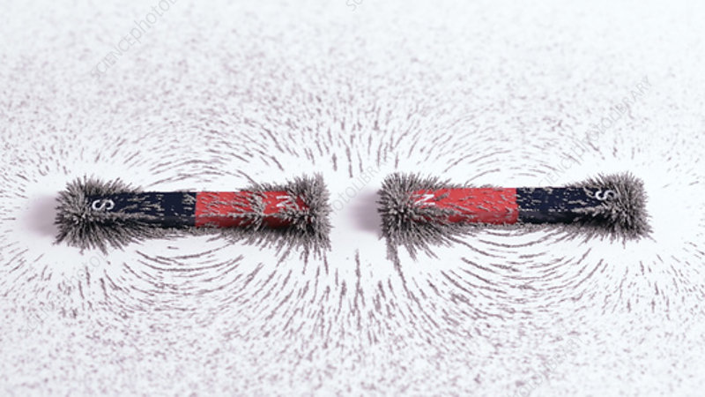
Magnetic Fields
When iron filings are sprinkled around a bar magnet, the filings form a pattern of curved lines that show the magnetic field. A magnet’s magnetic field can be represented by lines, called magnetic field lines. The lines are closest together at the poles, where the magnetic force is strongest. Where the lines are farther apart, the force is weaker.

Slide 10
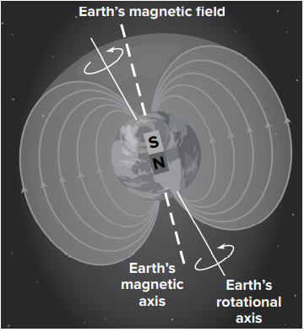
Earth Science Connection
As shown below, a magnetic field surrounds Earth. Earth’s magnetic field is due to molten iron and nickel in its outer core.
Earth has magnetic north and south poles.

Slide 11
Compasses
The needle of a compass is a small magnet. Like other magnets, a compass needle has a north pole and a south pole. Earth’s magnetic field exerts a force on the needle, causing it to rotate. If a compass needle is within any magnetic field, including Earth’s, it will line up with the magnet’s field lines.
A compass needle does not point directly toward the poles of a magnet. Instead, the needle aligns with the field lines and points in the direction of the field lines. Earth’s magnetic poles and geographic poles are not in the same spot. Therefore, you cannot find your way to the geographic poles with only a compass.

Slide 12
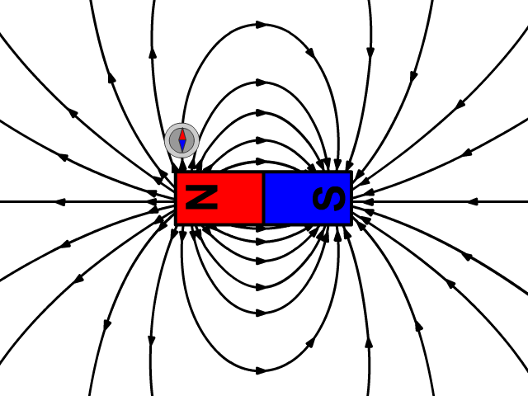

Slide 13
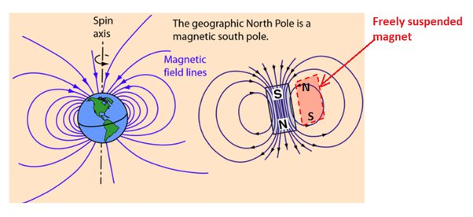

Slide 14
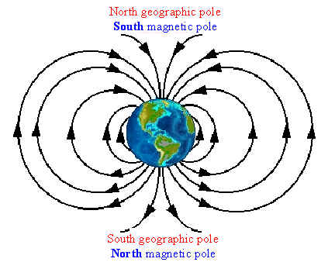

Slide 15
Magnetic Strength
Magnets can vary in strength. Stronger magnets have stronger magnetic fields than weaker magnets do.
Magnets have different uses call for magnets of many shapes, sizes and strengths.
Some are weak like the magnets that are holding papers on your refrigerator might be disc-shaped or flat and flexible. These magnets do not need to have a very strong magnetic field.
Others are strong like the ones used for a type of medical test called Magnetic Resonance Imaging (MRI) is about 200 time stronger than the magnetic field of a refrigerator magnet.

Slide 16
What happens when magnetic fields interact?
Potential energy is energy stored in an object because of its position.
Magnetic Potential Energy
Energy must be added to a magnetic field to separate two opposite poles. This increases the magnetic potential energy between the two poles.
Magnetic potential energy is stored energy that is the result of interactions of magnetic poles in a magnetic field.
The difference in potential energy depends on
the strength of the magnetic fields.
the orientation of the poles
and the distance between the two poles.

Slide 17
There are two ways to increase the magnetic potential energy between two magnets. *when two similar poles are pushed together. *when two opposite poles are pulled apart.

Slide 18
Transferring Magnetic Potential Energy
When a magnetic field applies a force that is strong enough to overcome the static forces of an object, the object moves.
When a magnetic force causes an object to move, it is doing work on the object. For example, when a paper clip moves toward a magnet, the magnetic field is doing work on the paper clip.

Slide 19
What makes a material act like a magnet?
Recall, all matter is made of particles called atoms. Every atom has its own magnetic field. If all atoms have magnetic fields, why do magnets not attract more materials, such as glass and plastic?
Magnetic Domains
In a magnetic material, atoms form groups called magnetic domains. A magnetic domain is a region in a magnetic material in which the magnetic fields of the atoms all point in the same direction.
The magnetic fields of the atoms in a domain combine, forming a single field around the domain. As a result, each domain is a tiny magnet with a north pole and a south pole.

Slide 20
Magnetic Domain
Magnetic Domain
groups of atoms with aligned magnetic poles
domain
in a magnetized object, domains are all aligned

Slide 21
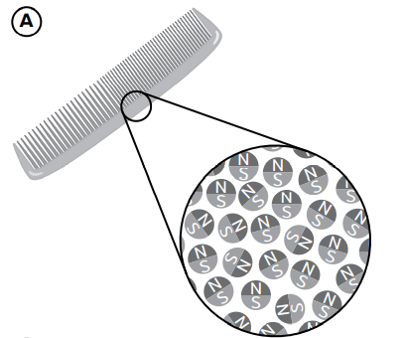
Nonmagnetic Materials
It is important to understand that while not all materials are magnetic, a magnetic field does surround every atom that makes up all materials.
Part A of the figure below shows how the magnetic fields of atoms in a plastic comb point in many different directions. The magnetic effects of the random magnetic fields cancel each other. There nonmagnetic materials do not have any magnetic properties and cannot be made into magnets.

Slide 22
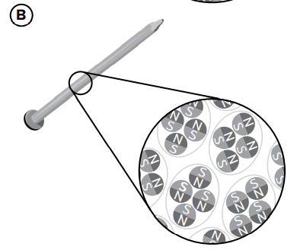
Magnetic Materials
In magnetic materials, atoms are grouped into magnetic domains. As shown in part B of the figure, the magnetic fields of the domains of the steel nail point in different directions. The magnetic fields of these domains cancel each other. This is why even though a steel nail is made of magnetic materials it is not a magnet.

Slide 23
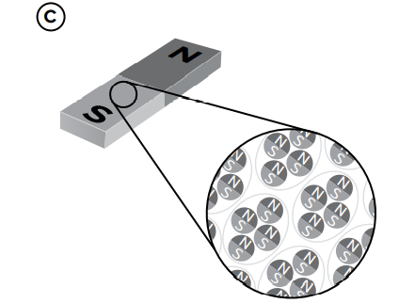
Magnetic materials become magnets
when the magnetic fields of the magnetic domains line up in the same direction. The magnetic fields of the magnetic domains of a bar magnet are lined up in the same direction.
This is shown in Part C of the figure. The magnetic fields of the domains combine to form a single magnetic field around the whole object

Slide 24
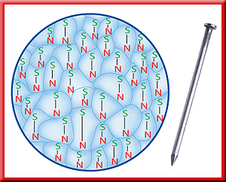
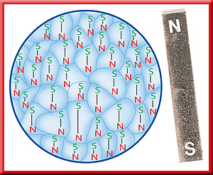
These atoms can be made to align by either passing an electric current through the material, or by placing the material next to a magnet. These methods, however, will only create temporary magnets.

Slide 25
Temporary and Permanent Magnets
placing the nail next to a magnet causes the domains in the nail to align along the bar magnet’s magnetic field lines.
As the poles of the domains of the nail point in the same direction, the nail becomes a temporary magnet.
Now the nail can attract other magnetic materials, such as paperclips, as shown in Part A of the figure below.

Slide 26
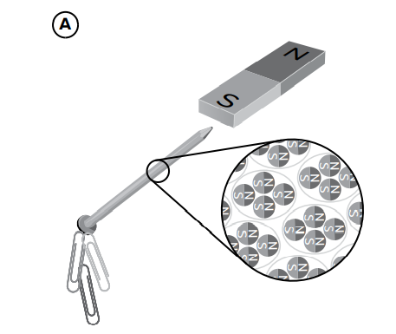
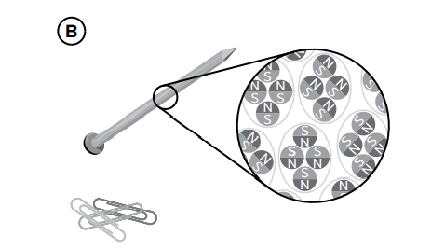
The nail becomes a temporary magnet. The nail is a magnet only when it is close to the bar magnet. This is shown in Part B of the figure. When the nail is moved away from the bar magnet, the poles of the domains in the nail return to pointing in different directions. The nail is no longer a magnet and no longer attracts other magnetic materials.

Slide 27
A magnet that remains a magnet after being removed from another magnetic field is a permanent magnet.
In a permanent magnet, the magnetic domains remain lined up.
Some magnetic materials can be made into permanent magnets by placing them in a very strong magnetic field. This causes the magnetic domains to align and stay aligned.
The material then remains a magnet after it is removed from the field

Slide 28
Some magnetic materials can be made into permanent magnets by heating the magnetic materials and allowing them to cool in a very strong magnetic field . This causes the magnetic domains to align and stay aligned . Even after removing it from the field .

